Slide 1
Data Driven AI
Week 1 - Lecture 2: Label Errors
Dr. Abirami Gunasekaran
CHS 2406: Data-driven AI

Slide 2
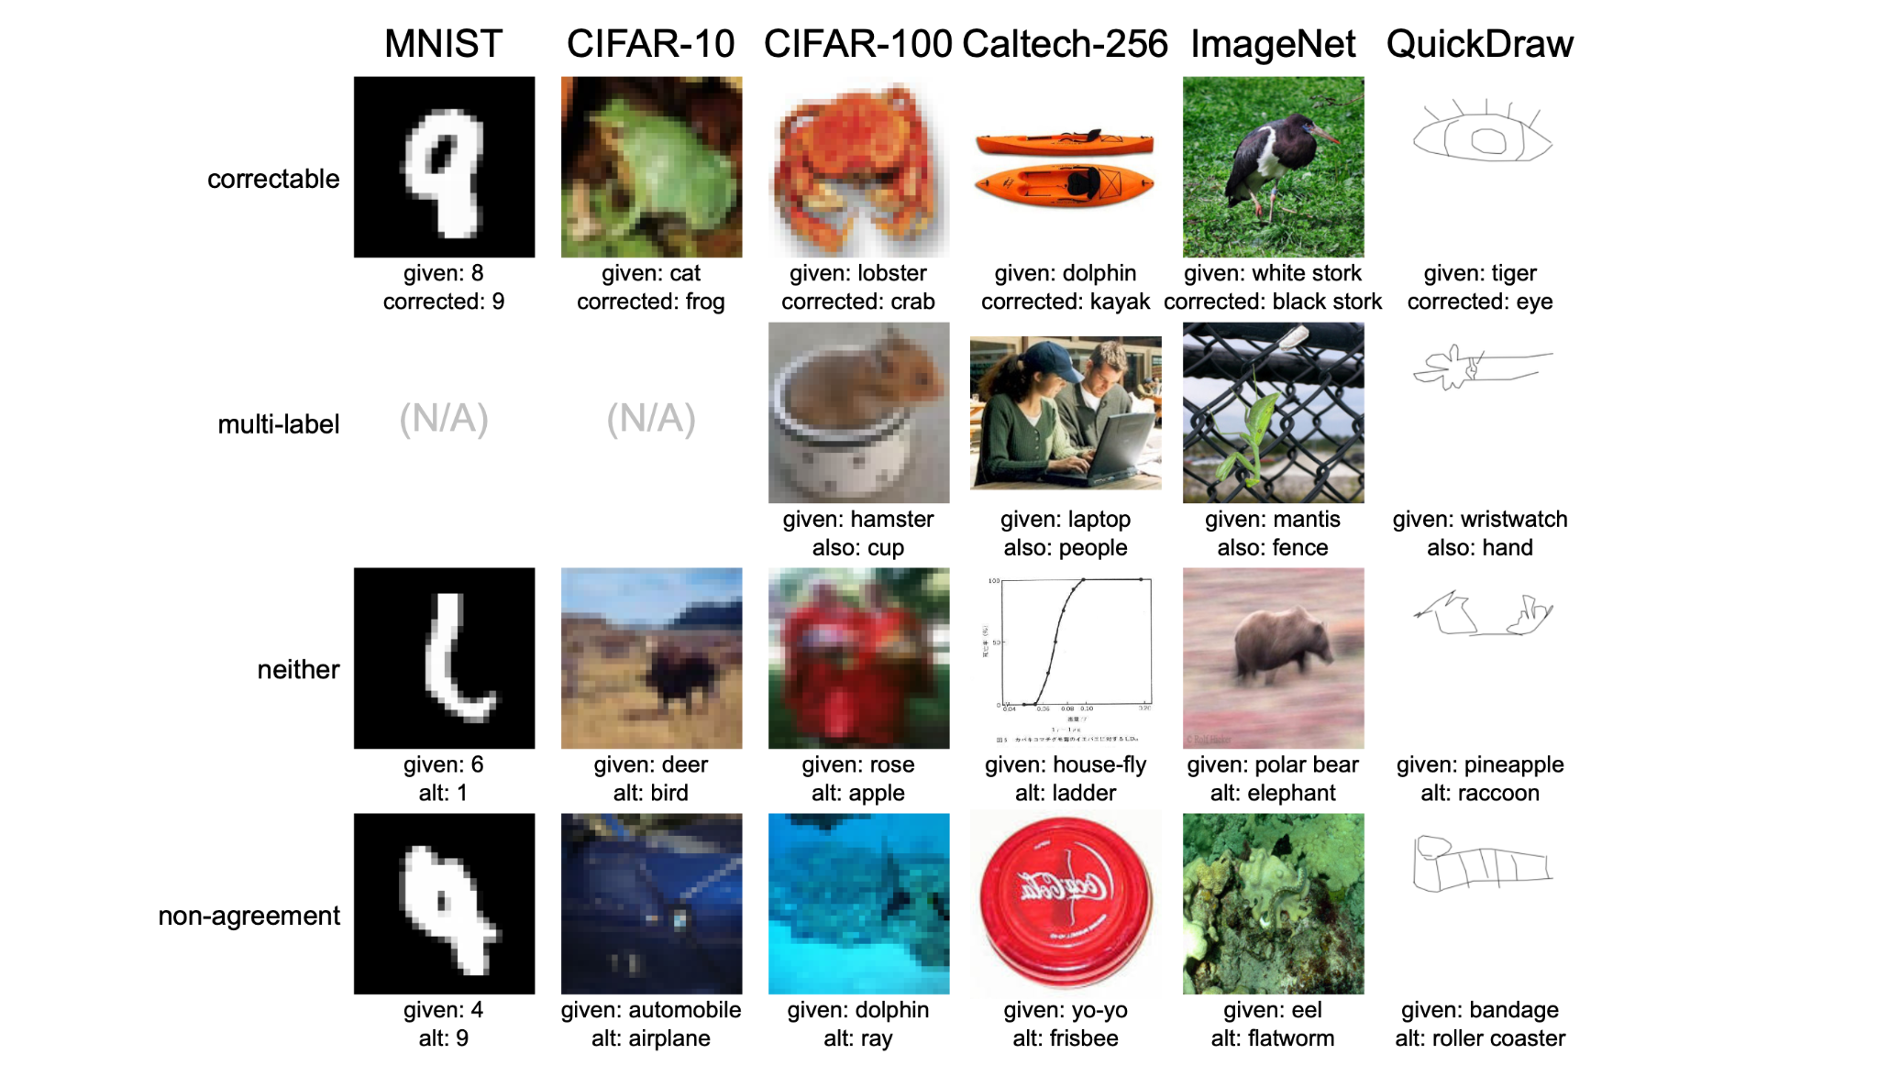
Examples from
https://labelerrors.com/
‘Hard’ Examples

Slide 3
Examples from
https://labelerrors.com/
Potentially out of distribution

Slide 4
Examples from
https://labelerrors.com/
More than one label for each data point

Slide 5
One correct label
Focus of this lecture.
Examples from
https://labelerrors.com/

Slide 6
Finding label errors by sorting data by loss?
Sure you can sort examples by loss, but what’s the cut-off?
How are you supposed to know how many label errors there are in the dataset without checking the errors by hand?
How do you automate this for large datasets?

Slide 7
Confident learning roadmap:
What is confident learning?
Situate confident learning
Noise + Other methods
How does CL work? (methods)
Comparison with other methods
Why does CL work? (theory)
Intuitions
Principles
Label errors on ML benchmarks

Slide 8
What is Confident learning (CL)?
Northcutt, Jiang, & Chuang (JAIR, 2021)
Confident learning (CL) is a framework of theory and algorithms for:
Finding label errors in a dataset
Ranking data by likelihood of being a label issue
Learning with noisy labels
Complete characterization of label noise in a dataset
Dataset curation
Key Idea:
With confident learning, you can use ANY model’s predicted probabilities to find label errors. (data-centric, modal-agnostic)

Slide 9
Where do noisy labels come from?
Clicked the wrong button (upvote/downvote, 1 star instead of 5 stars)
Mistakes
Mismeasurement
Incompetence
Another ML model’s bad predictions
Corruption and a million other places
All of these result in labels being flipped to other labels.
Examples of label flippings:
Image of a Dog is labeled Fox
Tweet “Hi welcome to the team!” is labeled Toxic language

Slide 10
What’s Uncertainty?
Uncertainty is the opposite of confidence.
It’s the “lack of confidence” (how uncertain) a model is about its class prediction for a given datapoint.
Uncertainty depends on:
the ‘difficulty’ of an example (aleatoric)
a model’s inability to understand the example (epistemic)
E.g. model has never seen an example like that before
E.g. model is too simple
Notes:
There are other types of uncertainty – correlated and uncorrelated

Slide 11
What’s Uncertainty? Epistemic vs Aleatoric Uncertainty
Example: machine learning with noisy labels
Aleatoric Uncertainty: Label Noise (labels have been flipped to other classes)
Epistemic Uncertainty: Model Noise (erroneous predicted probabilities)

Slide 12
Types of methods for Learning with Noisy Labels
Model-Centric Methods
“Change the Loss”
Use loss from another network
Co-Teaching (Han et al., 2018)
MentorNet (Jiang et al., 2017)
Modify loss directly
SCE-loss (Wang et al., 2019)
Importance reweighting
(Liu & Tao, 2015; Patrini et al., 2017; Reed et al., 2015; Shu et al., 2019; Goldberger & Ben-Reuven, 2017)
Data-Centric Methods
“Change the Data”
Find label errors in datasets
Then learn with(out) noisy labels by providing cleaned data for training
(Pleiss et al., 2020; Yu et al., ICML, 2019; Li et al., ICLR, 2020; Wei et al., CVPR, 2020, Northcutt et al., JAIR, 2021)
This lecture
We’ll see later why these approaches
propagate error to the learned model
Notes:
CL does other things besides being data-centric, but this is one aspect of confident learning

Slide 13
Are practitioners unknowingly benchmarking ML using erroneous test sets?
To answer this, let’s consider how ML traditionally creates test sets...
and why it can lead to problems for real-world deployed AI models.

Slide 14
A traditional view
Data Set

Slide 15
A traditional view
Test Set
Train Set

Slide 16
A traditional view
Test Set
Train Set

Slide 17
A traditional view
Test Set
Train Set
GREEN
RED
BLUE

Slide 18
A traditional view
Test Set
Train Set
GREEN
GREEN
RED
RED
BLUE
BLUE

Slide 19
A real-world view
Data Set

Slide 20
A real-world view
Data Set

Slide 21
A real-world view
Test Set
Train Set

Slide 22
A real-world view
Test Set
Train Set

Slide 23
A real-world view
Test Set
Train Set

Slide 24
A real-world view
Test Set
Train Set
GREEN
RED
BLUE

Slide 25
A real-world view
Test Set
Train Set
GREEN
GREEN
100% accuracy!
RED
RED
BLUE
BLUE

Slide 26
A real-world view
Trained Model with 100% test accuracy.
GREEN
RED
BLUE

Slide 27
A real-world view
Trained Model with 100% test accuracy.
Real-world distribution (the test set you actually care about)
GREEN
GREEN
BLUE
RED
RED
BLUE

Slide 28
A real-world view
Trained Model with 100% test accuracy.
Real-world accuracy ~ 67%
Key Takeaway:
Need to benchmark on a corrected test set
GREEN
GREEN
BLUE
RED
RED
BLUE

Slide 29
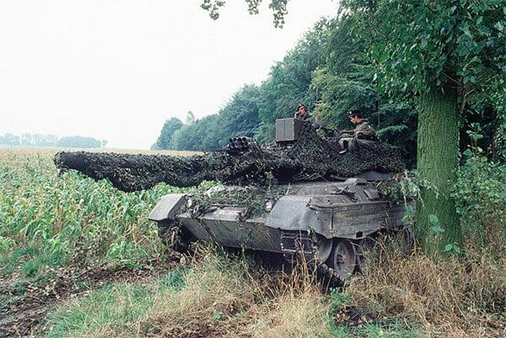
Identifying camouflaged tanks

Slide 30
Training a CNN.
100 of which contained camouflaged tanks hiding in trees
100 of which did not contain tanks and were images solely of trees/forest
Split data into an even 50/50 training and testing split
Training accuracy: 100%
Test accuracy: 100%
Successfully deliver the solution to pentagon!!!
Angry calls from Pentagon!
Model is perfuming poorly in real setting. <?><?><?>
Training data was captured on cloudy day
Testing data was captured on sunny day

Slide 31
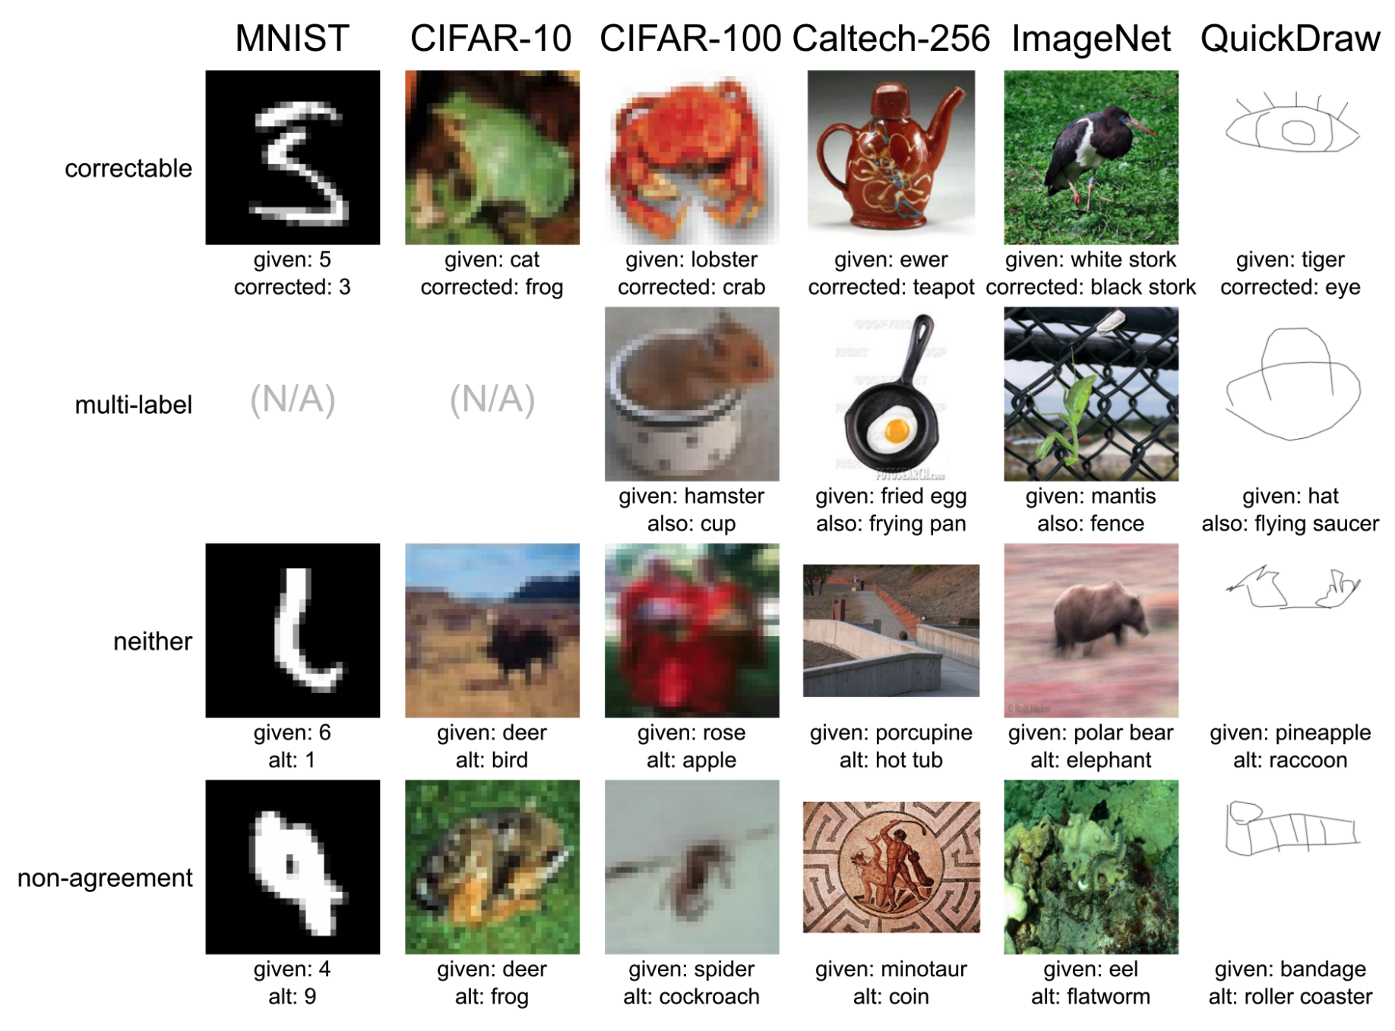
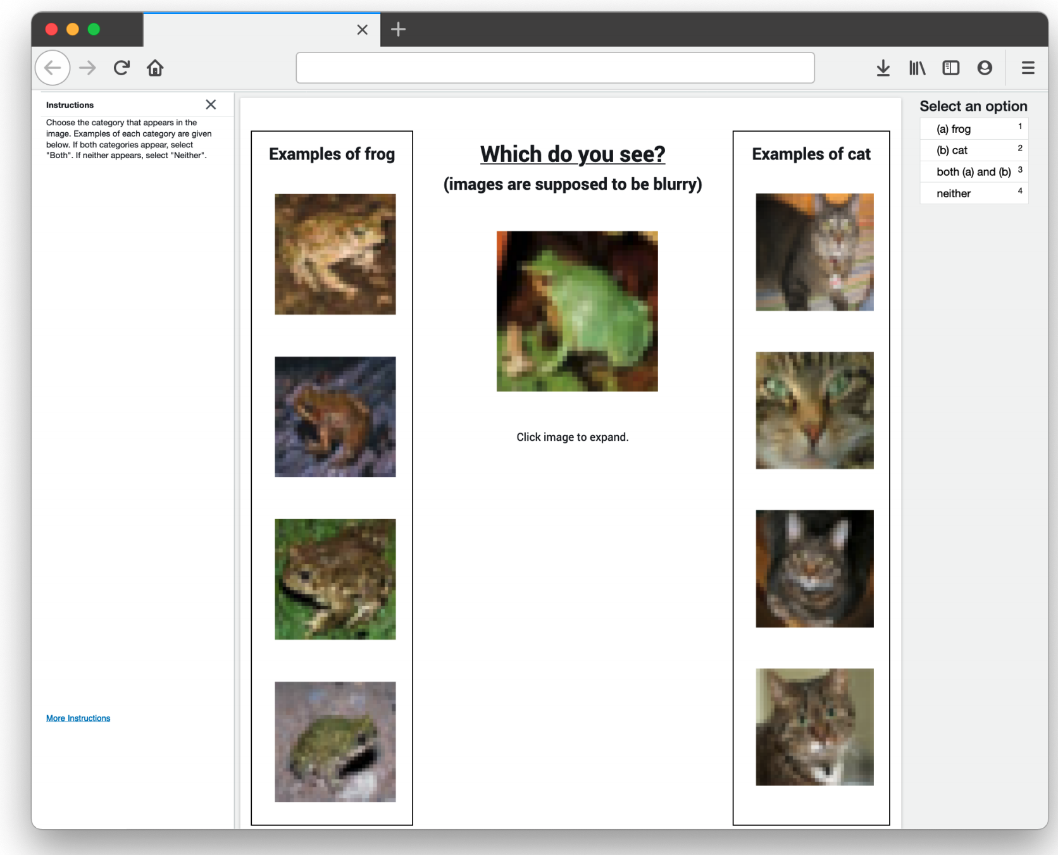
Correcting the test set

Slide 32
Correcting the test sets
Correct the label if a majority of reviewers:
agree on our proposed label
Do nothing if a majority of reviewers:
agree on the original label
Prune the example from the test set if the consensus is:
Neither
Both (multi-label)
Reviewers cannot agree

Slide 33
Are practitioners unknowingly benchmarking ML using erroneous test sets?
Conclusions
Model rankings can change with just 6% increase in noise prevalence (even in these highly-curated test sets)
ML practitioners cannot know this unless they benchmark with corrected test set labels.
The fact that simple models regularize (reduce overfitting to label noise) is not surprising. (Li, Socher, & Hoi, 2020)
The surprise -- test sets are far noisier than the ML community thought (labelerrors.com)
An ML practitioner’s “best model” may underperform other models in real-world deployment.
For humans to deploy ML models with confidence -- noise in the test set must be quantified
confident learning addresses this problem with realistic sufficient conditions for finding label errors -- and we have shown its efficacy for ten of the most popular ML benchmark test sets.
Notes:
Real world deployment which can have dire consequences for self driving cars

